Slide 1

Gender Recognition From Bangla Handwritten Dataset
PRESENTED BY
SUDIPTA DAS (A01-1112-117-005-2018)
KOUSTAV BAL (A01-1112-117-026-2018)
DEBARPAN GOSWAMI (A01-1112-117-009-2018)
DR. CHAYAN HALDER
SUPERVISOR

Slide 2
Contents
Introduction
Objective
Motivation
Related Work
Methodology
Result and analysis
Conclusion
Future Scope
Reference

Slide 3
Introduction
Gender classiﬁcation by handwriting analysis is a well-research subject, assuming that one’s gender can be predicted based on their handwriting style.
Most of the recent techniques to gender classiﬁcation from handwritten dataset have grown mainly around the similar a little datasets like the training and testing of these functions have been conﬁned typical to a handful dataset, like the Devanagari Characters Dataset, KHATT datasets.
Basically, we present a gender classiﬁcation method using Multilayer Perceptron(MLP), which is respectively easy and eﬃcient.
We have used a part of a large and diverse dataset, the EKUSH offline dataset which consists of 122 different characters from the Bangla language collected from 1500 various writers.

Slide 4
2. Objective
The objective of this project is to determine whether the gender of the writer is male or female or the original one that he or she claims.

Slide 5
3. Motivation
The motivation in this work is mainly twofold:
(1)Propose an improved gender classiﬁcation method.
(2) It has potential in the field of forensics to detect forgery and fraud.

Slide 6
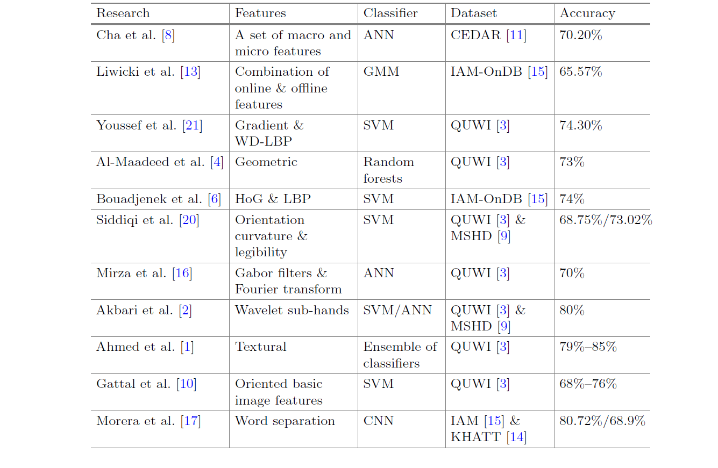
4. Related Work

Slide 7
5. Methodology
5.1 Activation Function: A Neural Network consists of layers of nodes which learn to map examples of inputs to outputs through the hidden layers of different levels. For a given node, the inputs are multiplied by the weights in the node and summed together. This value is known as the summed activation function.
In this experiment we have used 2 activation functions
ReLU Activation Function.
Tanh Activation Function.

Slide 8
5.2 The architecture of an artificial neural network: In order to define a neural network that consists of a large number of artificial neurons, which are termed units arranged in a sequence of layers.
Artificial Neural Network primarily consists of three layers:
Input Layer: It accepts inputs in several different formats provided by the programmer.
Hidden Layer: This layer presents in-between input and output layers. It performs all the calculations to find hidden features and patterns.
3. Output Layer: The input goes through a series of transformations using the hidden layer, which finally results in output that is conveyed using this layer.

Slide 9
5.3 Network Architecture :
(Our proposed neural network is MLP)
A neural network is a series of algorithms that endeavors to recognize underlying relationships in a set of data through a process that mimics the way the human brain operates
ANN basically is a computational model designed which consists of several processing elements that receive inputs and deliver outputs based on their predefined activation functions(In this model like we are using Tanh and ReLU).

Slide 10
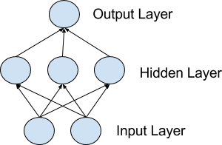
5.4 Multilayer Perceptrons or MLP :
1. MLPs are suitable for classification problems where inputs are assigned a class and are categorically labeled.
2. MLP is considered to be very flexible and can be used to make it learn a mapping from inputs to outputs.
3. MLPs are really feasible for tabular datasets(both images and text).
Fig : MLP
Imagesource:https://machinelearningmastery.com/wpcontent/uploads/2018/04/Network.png

Slide 11
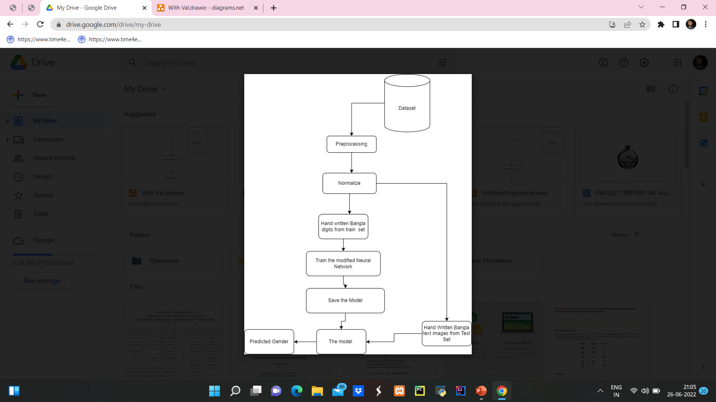
5.5 Visualization of Our Proposed Methodology: Our proposed Gender identification system from handwritten Bangla text images, can be visualized as follows

Slide 12
Dataset preparation with image Interpolation:
Data preprocessing is a very important step before we train our machine learning model.
1) In the preprocessing step we have only done the resize operation on the images.
2) We have chosen the target image size as 256X256(because our model accepts an image as input of size 256X256). But when we were trying to directly resize the images from their original size(e.g. 2480X2036) to the target size(256X256) the handwritten images were distorted.
3) Input Dimension: Size of Image: 28 x 28
Output Dimension : 2 [0,1] (which means male and female)

Slide 13
5.6 Training Model:
1. We have conducted two experiments with variations in hidden layers, activation functions(Tanh, ReLU),learning rate and epoch.
2. Our model basically takes in each data and categorically labels them. Then after the normalization process the dataset is split into training and test sets.
3. 27747 data out of 30830(roughly 90%) is sent to train set and about 3083 data left is sent to the test set(the rest 10%).

Slide 14
6. RESULT AND ANALYSIS
Experiment 1: Training with Tanh Activation Function
For this experiment, Tanh activation function is used with 128 hidden layer neurons.
This gives an accuracy of 57.9630 .
For this particular set of problems, no promising increase in accuracy is shown.
The total data is 30830, The optimizer we have used is SGD, and the activation function is Tanh.

Slide 15
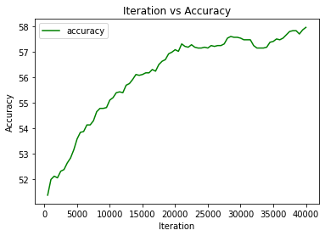
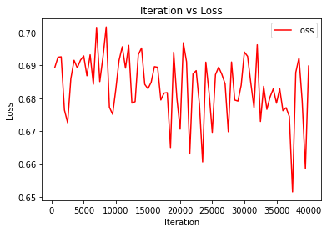
Epochs=40000 ÷ 27747 / 100 =144
Accuracy: 57.9630 and the Loss: 0.6897
The accuracy and loss curves are shown as the following:

Slide 16
Experiment 2-Training with ReLU activation
For this experiment, ReLU activation function is used with 128 hidden layer neurons.
This gives an accuracy of 61.9850 .
For this particular set learning rate is 0.001 and a considerable increase in accuracy is seen.
The total data is 30830.
The optimizer we have used is SGD, and the activation function is ReLU.

Slide 17
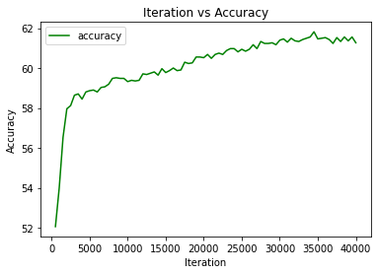
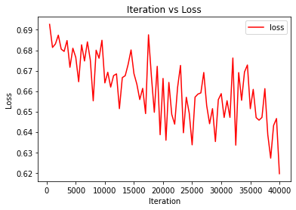
Epochs= 40000 ÷ 27747/100 = 144
Accuracy: 61.9850 and the Loss: 0.5941
The accuracy and loss curves are shown as the following:

Slide 18
Parameters | Experiment Setup 1 | Experiment Setup 2
Batch Size | 100 | 100
No. of iterations | 40000 | 40000
Epochs | 144 | 144
Learning Rate | 0.0001 | 0.001
No. of hidden neurons | 128 | 128
Activation Function | Tanh | ReLU
Optimizer | SGD | SGD
Accuracy | 57.9630 | 61.9850
Table representing a comparative study between two experiments

Slide 19
7. CONCLUSION
In this project we have propounded a simple neural network based on Multilayer Perceptron for Gender Recognition from handwritten Bangla hand written images.
We have devised a simple neural network architecture as per our requirements for the gender recognition task. For this project we have used an offline dataset called The Ekush Dataset.
We have shrunk the dataset into a dataset containing 30830 images only so that it would be easy to feed it to the MLP.
To select the model with optimum accuracy we have conducted 2 different experiments on our model both of the experiments are unique in their own way.
The accuracies we have got from these 2 experiments are approximately 57% and 61% respectively.

Slide 20
8. Future Scope
In the future to make our Gender Recognition model more resilient, we will make the gender recognition model on level
To make a good gender recognition system we may also design a CNN (Convolutional Neural Network) and modify it’s layers to extract the features of our images more efficiently and give a justifiable output.
We have to also develop a way to handle the actual size of the Ekush dataset so that we can work with the whole data in order to enhance our accuracy and reduce the loss of data.

Slide 21
9. REFERENCE
[1] Ahmed, M., Rasool, A.G., Afzal, H., Siddiqi, I.: Improving handwriting based gender classification using ensemble classifiers. Expert Syst. Appl. 85, 158–168 (2017)
[2] Akbari, Y., Nouri, K., Sadri, J., Djeddi, C., Siddiqi, I.: Wavelet-based gender detection on off-line handwritten documents using probabilistic finite state automata. Image Vis. Comput. 59, 17–30 (2017)
[3] Al Maadeed, S., Ayouby, W., Hassa¨ıne, A., Aljaam, J.M.: QUWI: An Arabic and English handwriting dataset for offline writer identification. In: International Conference on Frontiers in Handwriting Recognition, pp. 746–751. IEEE (2012)
[4] Al Maadeed, S., Hassaine, A.: Automatic prediction of age, gender, and nationality in offline handwriting. EURASIP J. Image Video Process. 2014(1), 10 (2014)
[5] Bandi, K.R., Srihari, S.N.: Writer demographic classification using bagging and boosting. In: Proceedings of the 12th International Graphonomics Society Conference, pp. 133–137 (2005)
[6] Bouadjenek, N., Nemmour, H., Chibani, Y.: Local descriptors to improve off-line handwriting-based gender prediction. In: 6th International Conference of Soft Computing and Pattern Recognition, pp. 43–47. IEEE (2014)
[7] Bouadjenek, N., Nemmour, H., Chibani, Y.: Age, gender and handedness prediction from handwriting using gradient features. In: 13th International Conference on Document Analysis and Recognition, pp. 1116–1120. IEEE (2015)

Slide 22
[8] Cha, S.H., Srihari, S.N.: A priori algorithm for sub-category classification analysis of handwriting. In: Proceedings of the Sixth International Conference on Document Analysis and Recognition, pp. 1022–1025. IEEE (2001)
[9] Djeddi, C., Gattal, A., Souici-Meslati, L., Siddiqi, I., Chibani, Y., El Abed, H.: LAMIS-MSHD: a multi-script offline handwriting database. In: 14th International Conference on Frontiers in Handwriting Recognition, pp. 93–97. IEEE (2014)
[10] Gattal, A., Djeddi, C., Siddiqi, I., Chibani, Y.: Gender classification from offline multi-script handwriting images using oriented basic image features. Expert Syst. Appl. 99, 155–167 (2018)
[11] Hull, J.J.: A database for handwritten text recognition research. IEEE Trans. Pattern Anal. Mach. Intell. 16(5), 550–554 (1994)
[12] King, R.N., Koehler, D.J.: Illusory correlations in graphological inference. J. Exp. Psychol. Appl. 6(4), 336 (2000)
[13] Liwicki, M., Schlapbach, A., Loretan, P., Bunke, H.: Automatic detection of gender and handedness from on-line handwriting. In: Proceedings of the 13th Conference of the Graphonomics Society, pp. 179–183 (2007)
[14] Mahmoud, S.A., et al.: KHATT: an open Arabic offline handwritten text database. Pattern Recogn. 47(3), 1096–1112 (2014)

Slide 23
[15] Marti, U., Bunke, H.: The IAM-database: an English sentence database for off-line handwriting recognition. Int. J. Doc. Anal. Recogn. 5, 39–46 (2002)
[16] Mirza, A., Moetesum, M., Siddiqi, I., Djeddi, C.: Gender classification from offline handwriting images using textural features. In: 15th International Conference on Frontiers in Handwriting Recognition (ICFHR), pp. 395–398. IEEE (2016)
[17] Morera, A., S´ ´ anchez, A., V´ ´ elez, J.F., Moreno, A.B.: Gender and handedness prediction from offline handwriting using convolutional neural networks. Complexity (2018). https://www.hindawi.com/journals/complexity/2018/3891624/ (as accessed on June 9,2022 at 4:00pm)
[18] Nair, V., Hinton, G.E.: Rectified linear units improve restricted Boltzmann machines. In: Proceedings of the 27th International Conference on Machine Learning, pp. 807–814 (2010)
[19] Shackleton, V., Newell, S.: European management selection methods: a comparison of five countries. Int. J. Sel. Assess. 2(2), 91–102 (1994)
[20] Siddiqi, I., Djeddi, C., Raza, A., Souici-Meslati, L.: Automatic analysis of handwriting for gender classification. Pattern Anal. Appl. 18(4), 887–899 (2015)
[21] Youssef, A.E., Ibrahim, A.S., Abbott, A.L.: Automated gender identification for Arabic and English handwriting (2013)

Slide 24
Thank You

